Slide 1
Introduction to Data Science Data Mining for Business Analytics
Brian d’Alessandro
Adjunct Professor, NYU
Fall 2015
Fine Print: these slides are, and always will be a work in progress. The material presented herein is original, inspired, or borrowed from others’ work. Where possible, attribution and acknowledgement will be made to content’s original source. Do not distribute, except for as needed as a pedagogical tool in the subject of Data Science.
Notes:
https://www.youtube.com/watch?v=aMDe5pODkB0 (harlan harris)

Slide 2
Exploratory analysis : Finding structure

Slide 3

discussion
What do we mean by data having structure?
Why do we want to understand it?
What do we do with it?
Notes:
The goal of finding structure is to information from one source to reduce uncertainty about another source.
What does this mean? Conditional distribution example. I.e., carnival guy who guesses your weight. If I can see your height I can reduce uncertainty about weight.
Find some height/weight data.
Under supervised exploration:
How can we (automatically) obtain a selection of the more informative variables with respect to predicting the value of the target variable?
Even better, can we obtain the ranking of the variables?
Can think of importance as one that makes the target variable more pure. This leads to the notion of entropy.

Slide 4
information
any quantity that can reduce uncertainty about another quantity
Notes:
The goal of finding structure is to information from one source to reduce uncertainty about another source.
What does this mean? Conditional distribution example. I.e., carnival guy who guesses your weight. If I can see your height I can reduce uncertainty about weight.
Find some height/weight data.
Under supervised exploration:
How can we (automatically) obtain a selection of the more informative variables with respect to predicting the value of the target variable?
Even better, can we obtain the ranking of the variables?
Can think of importance as one that makes the target variable more pure. This leads to the notion of entropy.

Slide 5
(aside) Conditional thinking
So much of what we do in data science involves thinking in terms of…
E[Y|X]
And deciding whether or not E[Y|X] ≠ E[Y]
From a decision making standpoint, conditional thinking is being able to make a better judgment about a potential outcome Y if we were to know the value of X.
Notes:
Do the demo as well

Slide 6
Types of structure
Pairwise (i.e., between 2 variables)
Global (i.e., across a matrix, or within a
set of variables)
Supervised (technically includes the
above, but with special emphasis
on a single target variable)
Notes:
The goal of finding structure is to information from one source to reduce uncertainty about another source.
What does this mean? Conditional distribution example. I.e., carnival guy who guesses your weight. If I can see your height I can reduce uncertainty about weight.
Find some height/weight data.
Under supervised exploration:
How can we (automatically) obtain a selection of the more informative variables with respect to predicting the value of the target variable?
Even better, can we obtain the ranking of the variables?
Can think of importance as one that makes the target variable more pure. This leads to the notion of entropy.

Slide 7
Ways to find structure
Measure covariance/correlation
Measure Mutual Information
Supervised Learning
Notes:
The goal of finding structure is to information from one source to reduce uncertainty about another source.
What does this mean? Conditional distribution example. I.e., carnival guy who guesses your weight. If I can see your height I can reduce uncertainty about weight.
Find some height/weight data.
Under supervised exploration:
How can we (automatically) obtain a selection of the more informative variables with respect to predicting the value of the target variable?
Even better, can we obtain the ranking of the variables?
Can think of importance as one that makes the target variable more pure. This leads to the notion of entropy.

Slide 8
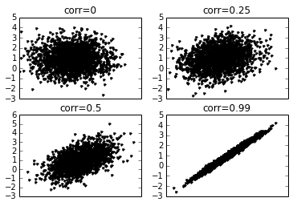
Covariance and correlation
These are probably the most used and thought of metrics when considering pairwise structure. These are statistical quantities and have a fairly intuitive geometric interpretation.
Scatter of Bi-Variate Normally Distributed Variables with various Correlations
Notes:
Do the demo as well

Slide 9
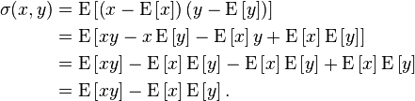

Covariance
Covariance
Sample Covariance (between Xj and Xk)
Note: I have decided to pull equations often from wikipedia, as I feel wp represents a crowd-sourced vote on notation standardization: http://en.wikipedia.org/wiki/Covariance
Notes:
Do the demo as well

Slide 10

correlation
Aka: Pearson-Product Moment Correlation Coefficient. This is just the covariance normalized by the variance of each variable. This scales correlation to the interval [-1,1], which makes it a very intuitive tool for analysis and reporting.
Correlation
Sample Correlation
Almost any programming language has standard functions for these formulas, but it doesn’t hurt to understand them!
Equation Source: http://en.wikipedia.org/wiki/Covariance
Notes:
Do the demo as well

Slide 11
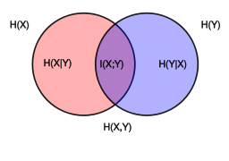

Mutual information
This comes from Information Theory, is used often for feature importance ranking and is related to important aspects of Decision Tree algorithms.
Mutual Information
Image and formula source: http://en.wikipedia.org/wiki/Mutual_information
Notes:
Do the demo as well

Slide 12
Mutual information
Let’s break this down
Mutual Information
This is in the form of E[F], i.e., E[X]=Σp(F)*F.
In this case, what is X?
Notes:
Do the demo as well

Slide 13
Mutual information
Let’s break this down
Mutual Information
F=log(p(x,y)/(p(x)*p(y))….but what is this?
Notes:
Do the demo as well

Slide 14
Mutual information
Let’s break this down
Mutual Information
F=log(p(x,y)/(p(x)*p(y))….but what is this?
This is a quantity with the following properties:
If X,Y are independent, F=0
If X,Y are completely dependent, F is at a maximum
F is symmetric (F(x,y)=F(y,x))
Notes:
Do the demo as well

Slide 15
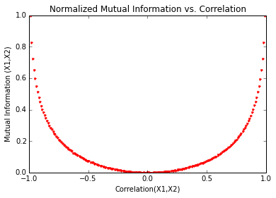
Mi vs correlation
Scikit-learn has functions for MI and normalized Mutual Information. We can see that MI and correlation are monotonically related concepts, though MI is strictly positive so does not indicate negative dependencies.
Notes:
Note, mutual information is the expected value of information gain.

Slide 16
Putting these to use
General understanding of dependencies in data
Validating assumptions for statistical modeling
Feature ranking and selection
Decision Tree Algorithms
Notes:
Note, mutual information is the expected value of information gain.

